Slide 1
Wordle Agent
Man v machine

Slide 2


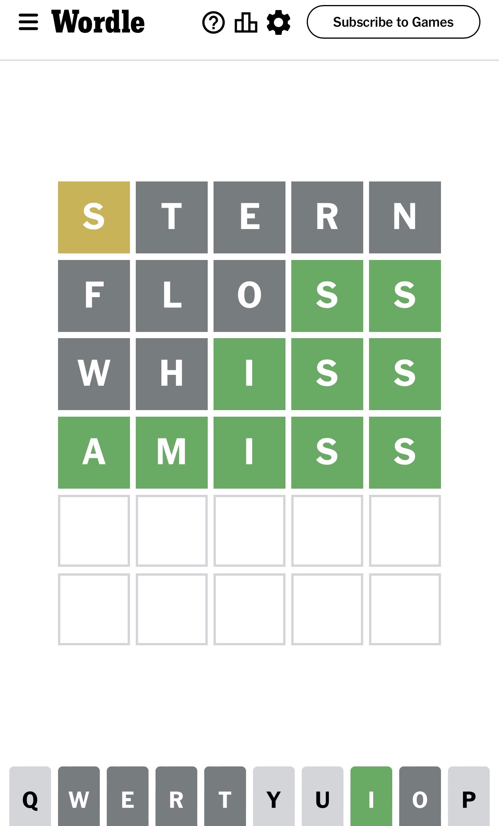
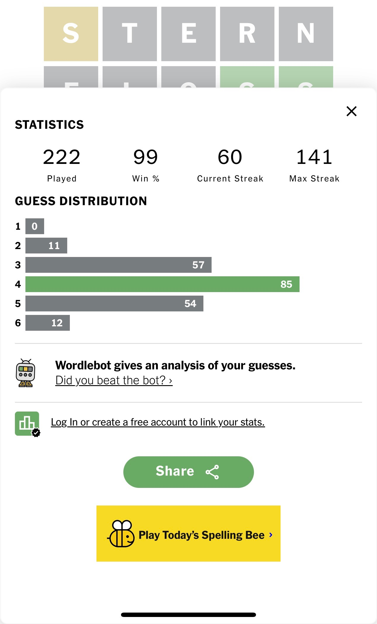



Obsessed with Wordle… and, I’m not the only one

Slide 3
Overall Strategy
3 Step Strategy
Pick a word from dictionary
Get feedback
Create a reduced dictionary that is consistent with feedback
REPEAT
Note that first pick is always a choice from the whole dictionary and every subsequent turn is a subset of this original dictionary
The question is: how do you pick a word that will get to the solution with in 6 guesses

Slide 4
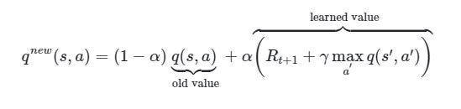
Bellman Equation

Slide 5

Bellman Equation
Assuming that your Q table is all zeros:
$\lim_{α→0}{Bellman eqn}$ = $\sum{αR}$
This is limits to the expectation value with the appropriate $α$ and 100% exploration policy (exhaustive search)
=> Q table is the table of Expected return for a change in state
Note that the coupling between rounds disappears in this limit
Markov property
So why is there a Bellman Equation?
The Bellman Equation represents a search pattern that will converge to the Q table efficiently
Remember, learning is about “good enough” and this algorithm gets to ”good enough” quickly and efficiently

Slide 6

What is the State?
If we look at the limit above, we can separate the game into guesses
In this case, the remaining dictionary defines your state
That means that the number of subsets of original dictionary is number of possible states
That’s $2^{2499}$!!!!!!!!!!!!

Slide 7

Closed form Q table
If we define Q to be the expected number of green letters, then there is a closed form solution (no training)
Note maximizing this Q will lead to winning the game
Q = $\left[\begin{aligned}\left[Histogram of 1st Letter\right] \\ \left[Histogram of 2nd Letter\right] \\ \left[Histogram of 3rd Letter\right] \\ \left[Histogram of 4th Letter\right] \\ \left[Histogram of 5th Letter\right]\end{aligned}\right]∶\left[\begin{aligned}\left[One Hot Enc of 1st Letter\right] \\ \left[One Hot Enc of 2nd Letter\right] \\ \left[One Hot Enc of 3rd Letter\right] \\ \left[One Hot Enc of 4th Letter\right] \\ \left[One Hot Enc of 5th Letter\right]\end{aligned}\right]$
Given any dictionary on left and target word on right
Note that this is an N^2 algorithm (pretty cheap)
With this dictionary, the first guess is ALWAYS “CORES”, because all games start with same state

Slide 8
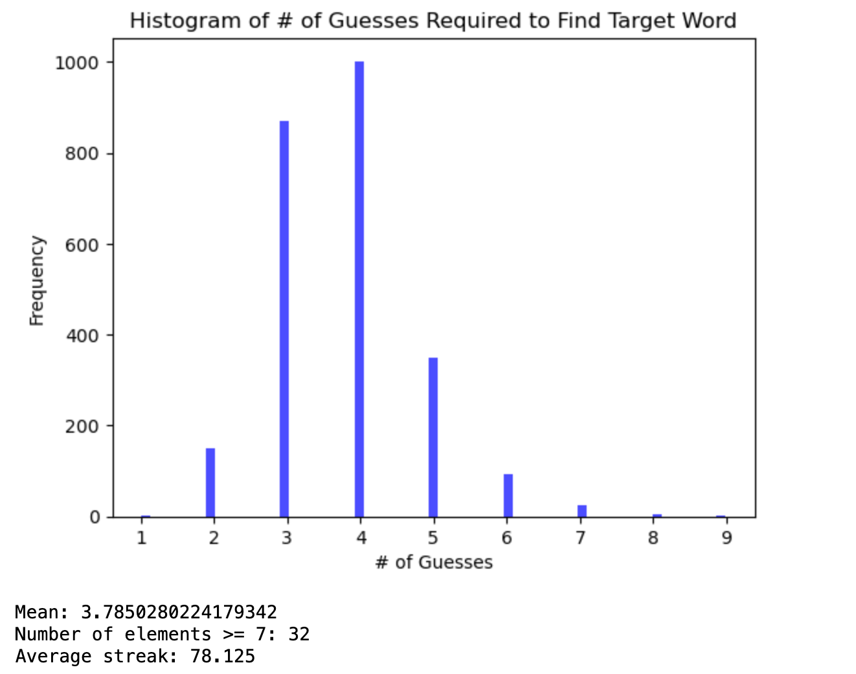
Results

Slide 9
Better Reward Function?
Since we are in a Reinforcement Learning class, we can propose possibilities where we can use simulation to estimate, or even determine the Q table
A better Reward Function could be the expected number of words from the dictionary that a guess will eliminate
Maximizing this may get to the solution faster
If we assume a 100% exploration policy, this would be an exhaustive search over the dictionary.
Most of the game has dictionaries of <200, so exhaustive search is not computationally onerous

Slide 10
Bears avoid sushi, trout laugh
Ok, given the above dictionary, how do we compute the Q table?
First play a game where “BEARS” is assumed to be the target word
Second, make a vector where each element is the number of words from the dictionary that each choice eliminates
[4, 2, 3, 3, 2]
Third, play a game with “AVOID” is assumed to be the target word
Add the resulting vector to the above vector
Repeat for all words
The result will be proportional to the exact Q table
The next guess is the word with the highest number (randomly choose if tie)
Note that this is a N^3 algorithm (getting expensive)
Remove guess from resulting resulting dictionary (once guess is made).

Slide 11
In Practice…
With 2499 word dictionary, the above algorithm took 2 hours on my computer.
The result was “CARES”
Note that this will ALWAYS be the first guess, so we only have to do this once
In reality, the algorithm converged to “CARES” in about a few hundred simulations
Each subsequent guess is instantaneous because the dictionary is reduced to ~100 words
So pick “CARES” first and then play with the algorithm for subsequent guesses
This takes about 20 minutes to get through all games

Slide 12
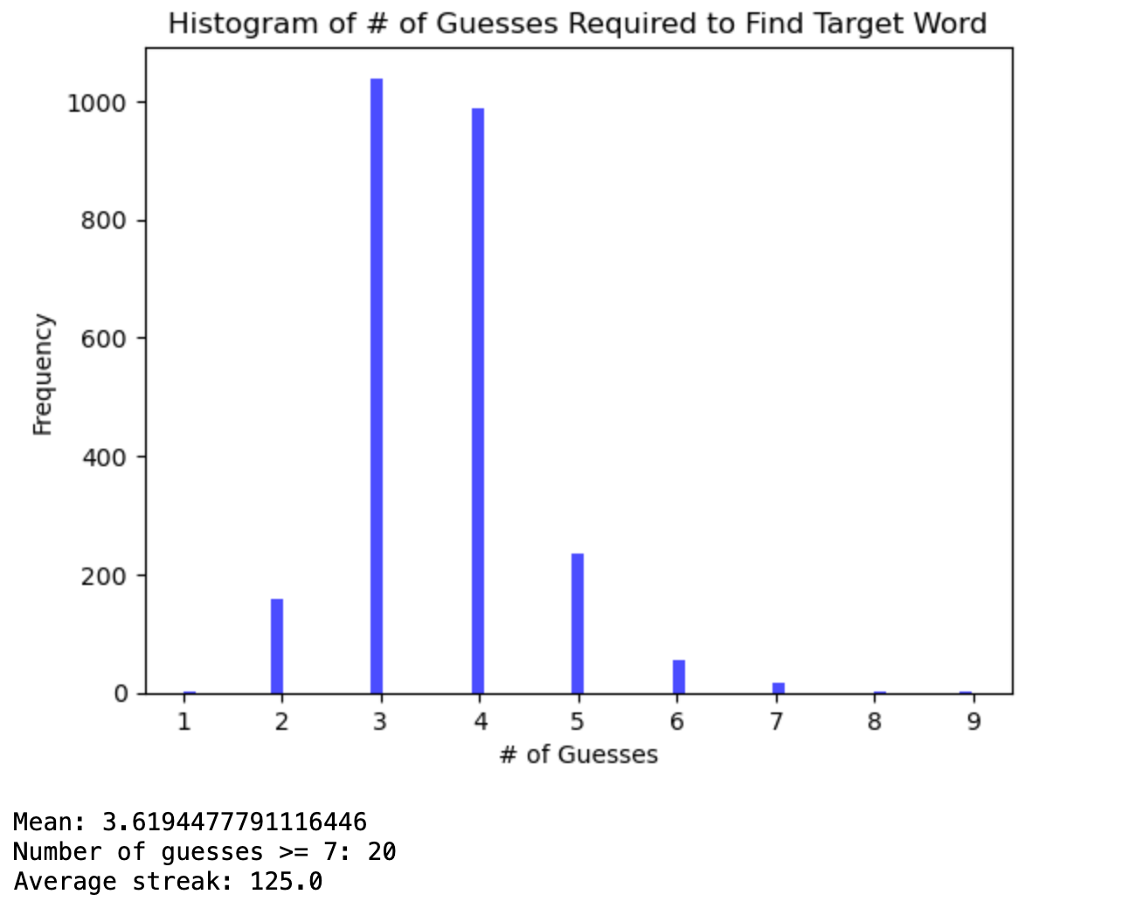
Compare Performance
Closed Form Approach
Trained Approach

Slide 13
Results

Slide 14
Future Directions
With the 2499 word dictionary, the algorithm converged to the “CARES” in a few hundred simulations
Remember, in learning, we are not looking for an exact answer, but ”good enough”
This implies that a more traditional approach could be fruitful
The State would be the number of the guess
The Reward would the number of dictionary words eliminated by guess given every target word possible at the stage of the game
The Policy would be a more realistic balance between exploration and exploitation

Slide 15
There may not be a materially better strategy
This game is viral
No one would play this game if you were guarantied a win
It is reasonable to assume that 6 guesses is challenging enough to keep you playing
Fewer guesses and you don’t win enough to keep your interest
More guesses and you would always win, and it would no longer be enough of a challenge

Slide 16
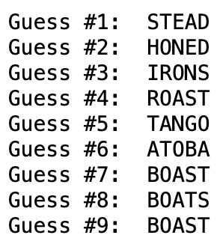
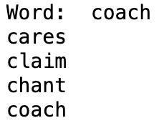
ChatGPT based?
Typical Game
ChatGPT Based Game

Slide 17
ChatGPT IS NOT THE RIGHT TOOL!
The tokenization is based on meaning, not structure
Wordle is not a meaning based game, it is a structure based game
Maybe a transformer that uses One Hot Encoding would be better
This is a future development
It may be simple enough for us to implement v a LLM transformer
Does anyone want to work with me on this?

